Slide 1

NETFLIX’S
MARKET RESEARCH & ANALYSIS

Slide 2

HISTORY
Founder : Reed Hastings, Marc Randolph
Launched as a mail-based rental business (1997 - 2006)
Hastings invested $2.5 million into Netflix.
Initially, Netflix offered a per-rental model for each DVD but introduced a monthly subscription concept in September 1999.
In September 2000, during the dot-com bubble, while Netflix was suffering losses, Hastings and Randolph offered to sell the company to Blockbuster LLC for $50 million.
In 2004, Netflix was sued for false advertising.

Slide 3
Major Milestones
In 2011, Netflix became the largest streaming platform in North America. Later it expanded to many cities in 2015.
As of December 31, 2021, Netflix had over 221.8 million subscribers worldwide
In 2007, the company launched a streaming media service.

Slide 4
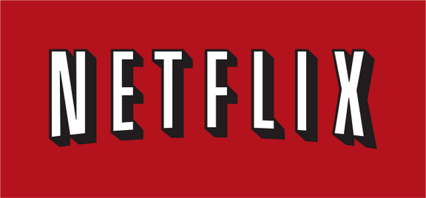



NETFLIX LOGO & DESIGNERS
FROM 1997 TO 2016
Designed by- New York based Gretel
Graphic Designer - Joe Mason

Slide 5
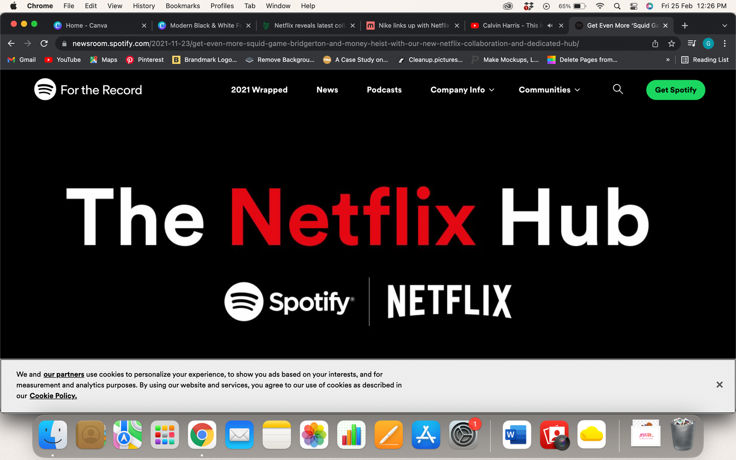
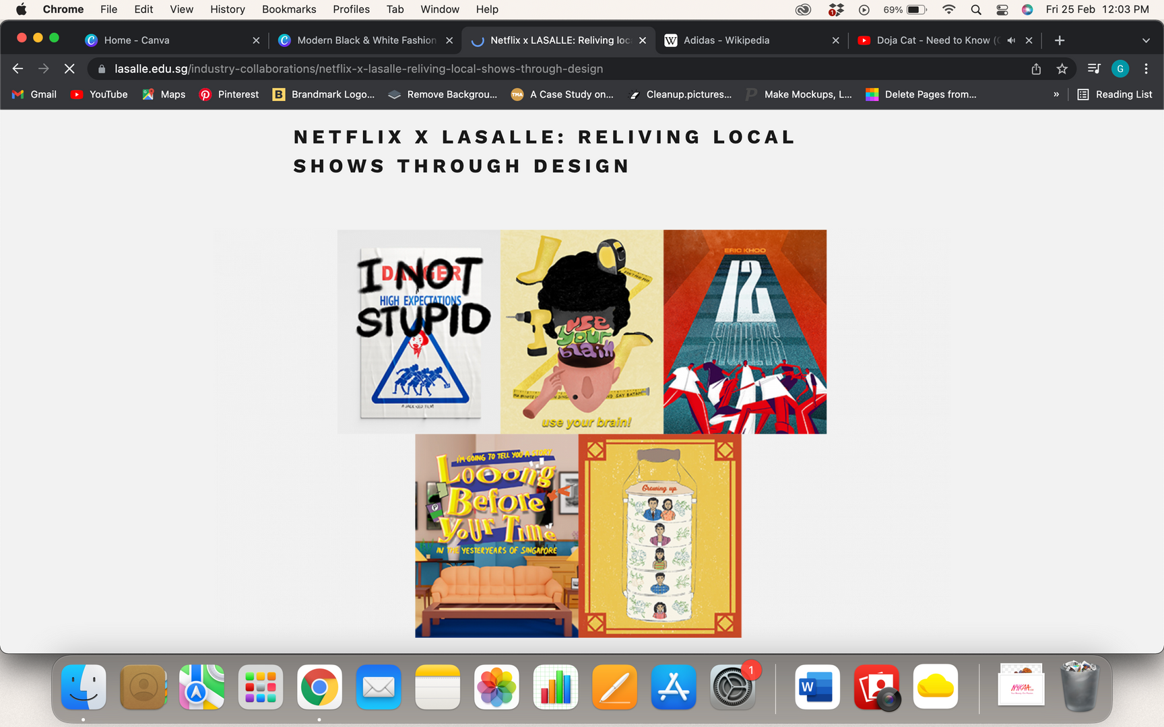
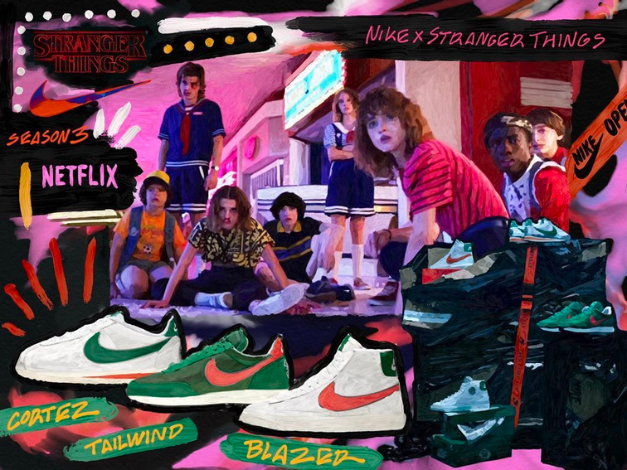
COLLABORATIONS
Netflix X Nike

Slide 6
MARKETING MIX
Netflix has introduced numerous techniques of evolving the marketing mix to raise its sales and produce profits, to its success, and has cut through the competing clutter and reached out to its intended audience by curating a few innovative brand communication strategies over the years.
A marketing mix is a tool that assists the company to build its foundation stronger than ever. This gives a smart way of figuring out the outcomes of the brand through 4Ps strategies.
4Ps strategies are typically known as Product, Price, Place, and Promotion.

Slide 7
Product Strategy
Price Strategy
It is a website where you can register and pay to watch TV shows, movies, documentaries, and many more.
The coolest part of Netflix is, there are no commercials while you are enjoying the content.
Netflix is available in India with three different plans:
Basic plan -Rs 500 per month
Standard plan - Rs 650 per month
Premium plan- Rs 800 per month.
Place Strategy
Promotional Strategy
The content provided by the brand is available in more than 190 countries.
Its services are accessible through Smart TVs, tablets, and smartphones with the internet.
The online streaming network has been constantly promoting and advertising its services in different ways.
Primarily, the fundamental source of the promotion is social media websites including YouTube.

Slide 8
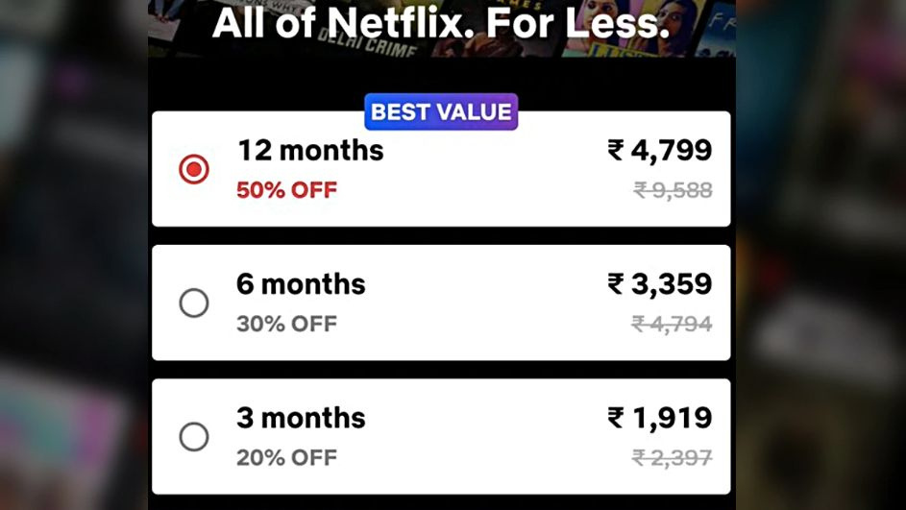
Marketing and sales promotion techniques
Coupons and discounts

Slide 9
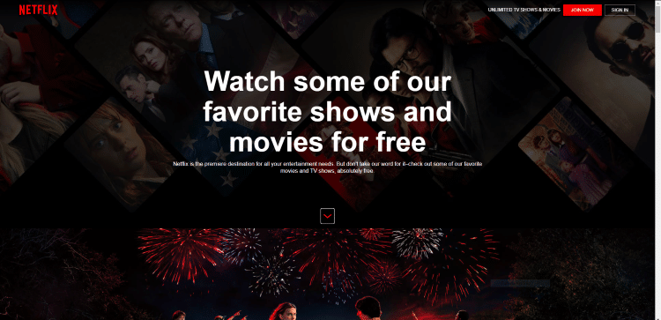
Marketing and sales promotion techniques
Product Samples
NETFLIX TEASES POTENTIAL SUBSCRIBERS WITH A TASTE OF POPULAR SHOWS FOR FREE

Slide 10
Insights and Conclusion
Netflix evolved significantly from a mail-based rental service to the world's largest streaming platform with 221.8 million subscribers by December 31, 2021.
Despite challenges like the 2004 false advertising lawsuit, Netflix strategically adapted its marketing mix.
The company emphasizes product excellence, competitive pricing, and extensive global accessibility.
Effective promotion on social media, particularly YouTube, contributes to Netflix's market position.
The success of its 4Ps strategies showcases Netflix's commitment to innovation and customer satisfaction, establishing it as a prominent player in the streaming industry.

